Slide 1
Introduction to Machine Learning
Explore ML

Slide 2
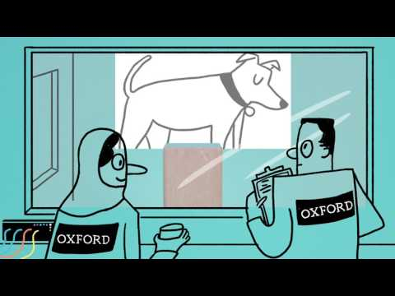
Notes:
Questions after the video:
How would you define machine learning?
Answers could include:
Machine learning is a specific field of AI where a system learns to find patterns in examples in order to make predictions.
Computers learning how to do a task without being explicitly programmed to do so.
What questions do you have?
What was interesting or surprising?
Video Source: OxfordSparks Youtube Channel, What is Machine Learning? (2:20) CC Licenced

Slide 3
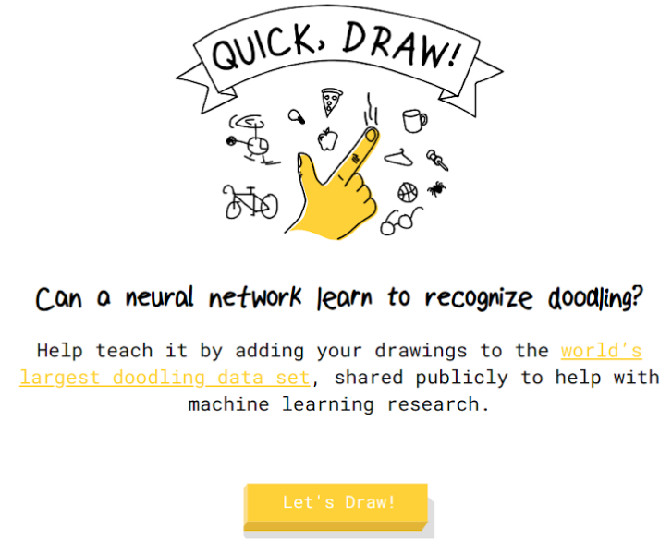
Quickdraw Game
g.co/quickdraw
g.co/ quick draw
Notes:
Machine learning is used in a growing number of applications. Though it is not a replacement for every task.
In this activity, you'll explore an example of machine learning. Enjoy the activity and see if you can form a hypothesis or evidence-based theory on how it works. We'll use this to develop an understanding of how machine learning works.
Open the internet browser on your computer and go to g.co/quickdraw.
[Allow 10 minutes for students to try out the activity]
Screenshot of Quickdraw. Source: Google

Slide 4

Quickdraw Game - Discussion
How does the game work?
How is it recognising your drawings?
Further enquiry: How could we program this?
Notes:
[Spend 5-10 minutes discussing the questions on the slide. Discussion note: Encourage ideas and creativity. This is not about being right.]

Slide 5

How does ML work in QuickDraw?
g.co/quickdrawdata
g.co/ quick draw data
Notes:
Here is a clue to how the game works. There is a large amount of data used to teach this game how to recognize images. If you go to g.co/quickdrawdata you can see a lot of examples for an object. In this slide are some of the examples for carrot.
If you were going to describe what a carrot was to someone who had never seen one before using only these images. How would you describe it?
[Encourage a discussion where learners describe a carrot using the images, they could use shapes like triangle or key characteristics such as a the leafy root on top or lines]
Screenshot of Quickdraw Data. Source: Google

Slide 6
Quickdraw: Rule-based
Frame the goal of the product
if object.height > 10:
do x
if object.color is blue:
do y
if object.numberOfLegs > 2:
do z
...
Designers and engineers develop flow and logic
Refine until goals are met
Notes:
You may already be familiar with traditional programming where you start with a goal, write logical rules, and refine through testing until it works the way you want it to.
Imagine if you tried to describe a carrot the way you just described using traditional programming rules such as those on the right side of the slide. This approach would get very complicated especially if you wanted to account for all of the possible ways one could draw an object.

Slide 7
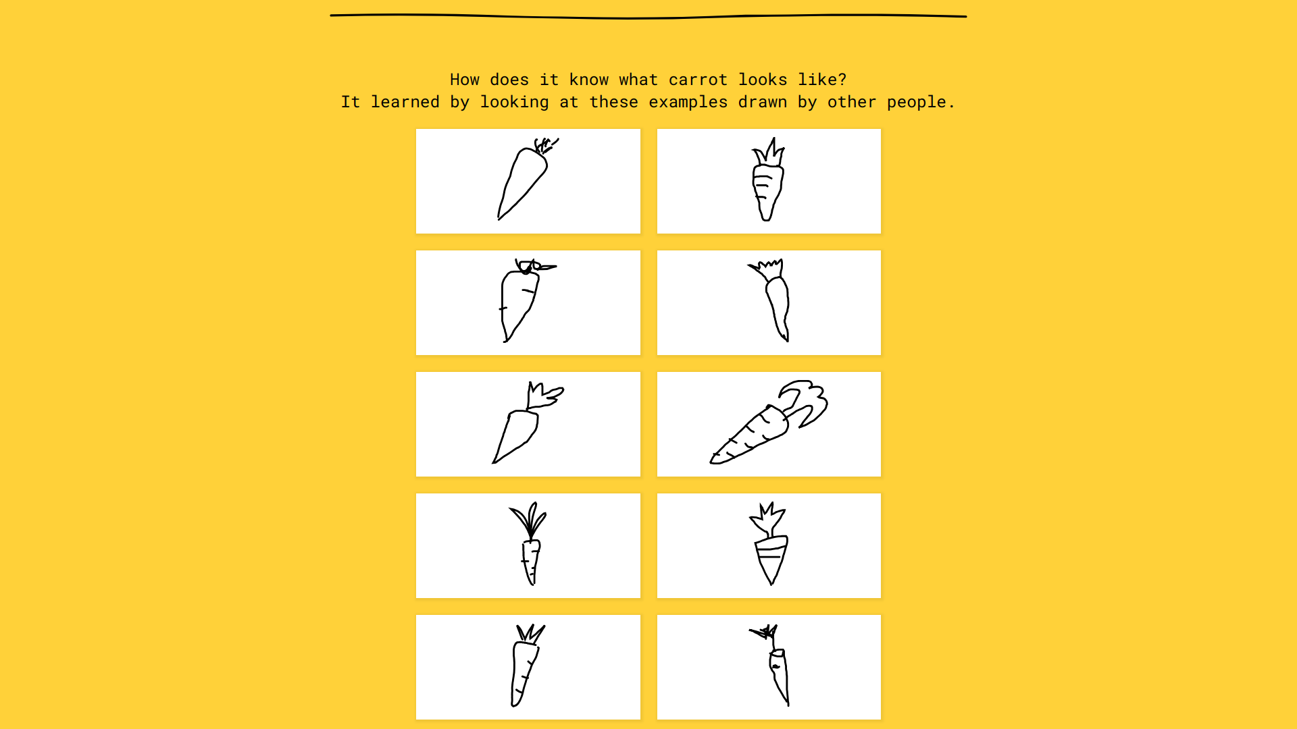
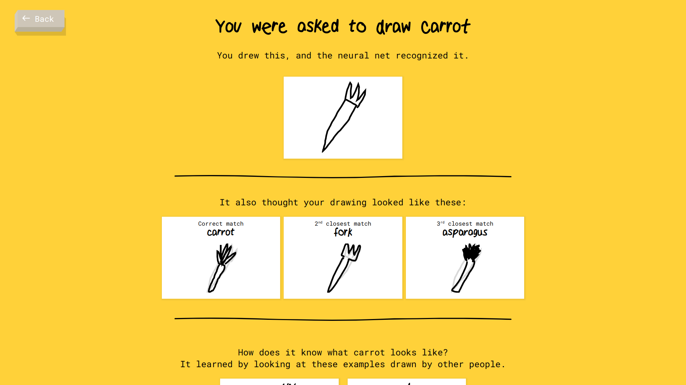
Quickdraw: Machine Learning
Frame the goal of the product
Train a model using examples
Refine until goals are met
Notes:
Machine learning is an alternative approach to building software. Instead of programmers creating the rules, a model is trained with examples. Rather than trying to define for the computer what a carrot is and account for all of the possibilities, the computer is given lots of varying examples like you saw in the Quickdraw data and told this is a carrot, this is a carrot, and this is a carrot.
This approach results in a more flexible understanding.
Question: What might be a limitation of a machine learning approach?
The machine learning model is only as good as the examples.
For example if all of the examples are triangle shaped, it might fail to recognize a rectangular shaped drawing as a carrot.
Question: What type of tasks do you think would be a good fit for machine learning?
Have students discuss and debate.

Slide 8
Which Approach to Use?
Rules-based approach
Rules-based
Alphabetising a list of song titles
Machine Learning
Notes:
[Animated slide: Click to show answer]
Answer: Traditional programming/rules-based.
Ask why. Explanations could include:
There are sorting rules/algorithms well suited for this task.
There are a fixed number of letters in the alphabet so there are only so many rules one would need to write.

Slide 9
Which Approach to Use?
Rules-based approach
Rules-based
Ranking Web Search Results
Machine Learning
Machine Learning
Notes:
[Animated slide: Click to show answer]
Answer: Both rules-based and machine learning systems could work well here.
Ask why. Explanations could include:
The approach you take would depend on your goal. Are you ranking web results based on relevance to my query? If the query was news, you might also want to take into account how recently the article was posted.

Slide 10
Which Approach to Use?
Rules-based
Predicting Housing Prices based on Location
Machine Learning
Machine Learning
Notes:
[Animated slide: Click to show answer]
Answer: Machine learning
Ask why. Explanations could include:
There is no perfect formula determining how much a home would cost based on its location.
There are other factors that could play a part in how much a home price costs.

Slide 11
Which Approach to Use?
Rules-based approach
Rules-based
Processing online payments
Machine Learning
Notes:
[Animated slide: Click to show answer]
Answer: Rule-based approach
Ask why. Explanations could include:
Online payments are a straightforward logical process. It is possible for a programmer to confidently program the exact steps necessary.
Fraud detection, knowing whether a credit card number was stolen and used inappropriately is much more complex and hard to define. Machine learning could be used for this specific part of an online payment system.

Slide 12
Which Approach to Use?
Rules-based
Classifying an object in a photo
Machine Learning
Machine Learning
Notes:
[Animated slide: Click to show answer]
Answer: Machine learning.
Ask why. Explanations could include:
There are too many variables to try and create rules for every situation.
No two photos are alike, so even a photo of a famous landmark could be captured at different angles, times of day/lighting. This would make it much harder to define what an object is in code. Machine learning builds a representation from many examples like this so it can be more flexible and able to handle these situations.

Slide 13
Recap
Rule-based Approach
Machine Learning
Rules are defined
Improvements come from algorithms and network
Learns patterns from data
Improvements can from additional data
Each has its benefits
Notes:
Machine learning will not become the default option for software. It is best suited for certain situations but not all.
Question: What are other examples of machine learning you could imagine?

Slide 14
Idea to Implementation
Notes:
While machine learning offers powerful new opportunities, implementing a machine learning system can be more complex than traditional software. This is primarily because a machine learning system is only as good as the data it is trained on. In this section, I'll provide an overview of the process as well as important considerations.

Slide 15
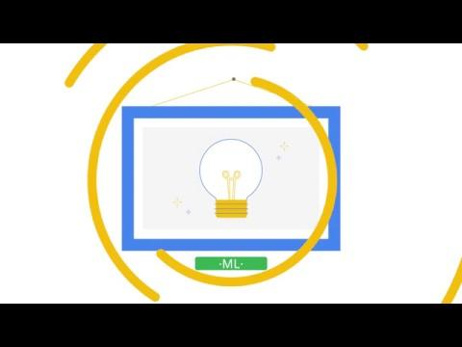
Notes:
Play the video.
Video Source: Google (4:20)

Slide 16





Machine Learning Process
Collect Data
Predict and
Evaluate
Focus on User
Define Objective
Train and Test Model
Notes:
Machine learning begins with the needs of your user and business.
With this in mind, you define an objective so you know how to proceed.
Examples could include:
Predict which friends a user is likely to share a photo with.
Suggest the user should eat in a new city based on the restaurants they have visited in the past.
These goals should articulate success metrics as well.
Machine learning models learn from examples so it is essential to find a large existing source of data that is relevant to your problem.
Experts say, collecting, cleaning, exploring, and other data processes tend to be the longest but most critical part of the process.
The arrow pointing back from prediction to data shows the iterative nature of ML. You will need to refine your model and perhaps your data collection and processing based on the feedback until it is achieving the results you are looking for.

Slide 17
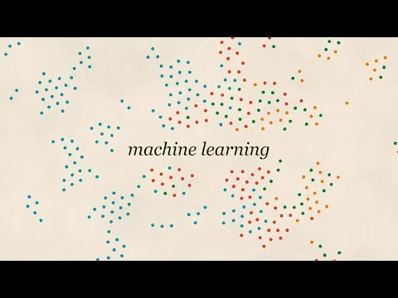
Notes:
Before video:
Humans are prone to trust results from a computer. We assume our technology will work as designed until it breaks.
However, even a well designed machine learning pipeline can experience issues when it picks up on biases found in the data.
After video:
Question: When someone describes to you a new application of machine learning, what questions would you ask them based on this video?
Question: What approaches could a software development team take to mitigate bias in their machine learning system?
Video source: Google, Machine Learning and Human Bias (2:20)

Slide 18
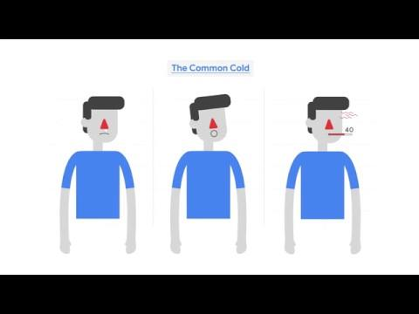
Notes:
After the video share these key points:
Gather and select only the data that your ML system needs to achieve its goal. The less data you have in the first place, the less you need to protect. This might seem like common sense, but it takes effort. (It's easier to copy a whole database into your ML system than to spend hours removing the parts that you don’t need.) Strip away data that your model doesn't need.
Various laws and company policies regulate how data must be kept private. A machine learning product needs to be compliant with every country it has customers and users.
Video source: Google

Slide 19
What Can ML Do?
Notes:
It's easy to look at examples of machine learning and see it as magical. It does open a lot of new possibilities with technology.
We already considered for certain situations, whether ML was necessary. In this section, we will discuss what type of problems ML is best suited for.

Slide 20
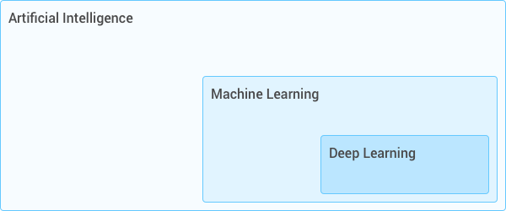
Artificial Intelligence
Machine Learning
Deep Learning
Notes:
In news articles and discussions, it's common to hear artificial intelligence (AI), machine learning (ML), and deep learning (DL) used interchangibly but there are distinctions between them
AI
Artificial Intelligence is defined as any technology which appears to do something smart.
This can be anything from programmed software to deep learning models which mimic human intelligence
ML
Machine learning is a specific kind of artificial intelligence but rather than a rule-based approach, the system learns how to do something from examples rather than being explicitly told what to do.
DL
Deep learning is a specific type of machine learning using a technique known as a neural network which connects multiple models together to solve even more complex types of problems.
Deep Learning, similar to other ML models, learns via examples. It's unique because it connects models to other models in layers in order to handle more complex types of data like as images.
Diagram source: Google (author: ostrowskid@)

Slide 21
Big Data
Algorithms
ML
Technology
Notes:
That brings us to this very simplified overview of the history of machine learning. You can find more detailed timelines on Wikipedia etc but here's the main takeaway.
The key algorithms powering machine learning were formulated even as much as centuries ago. They come from disciplines like statistics, linear algebra, biology, physics.
For the last few decades, sufficiently large amounts of data were collected to train models but they were low quality and expensive to train. Lack of progress and prospects led to an "AI Winter" where ML was considered a waste of time.
In the last few decades, the availability of relatively cheap and fast computing power have enabled the complex calculations across large sets of data necessary to train highly accurate models.
If learners are interested in more details they can visit:
https://wikipedia.org/wiki/Timeline_of_machine_learning
https://cloud.withgoogle.com/build/data-analytics/explore-history-machine-learning/

Slide 22
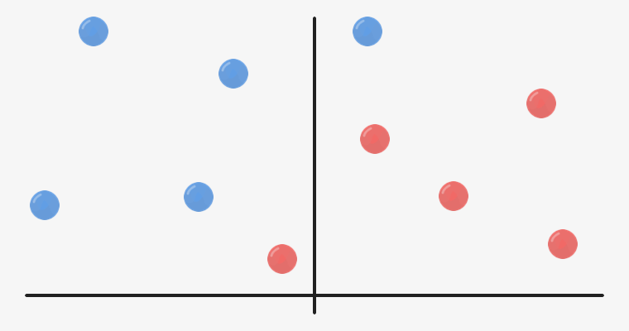

Classification
LION
WILDLIFE
MAMMAL
Notes:
Classification is a common application of machine learning.
The system determines which class or category an example belongs to.
The output can be a label and a percentage of confidence.
For example if the classifier was trained to identify whether or not an image was of a lion it might output "Yes" or "No", however if it was more generically an animal classifier the output could be "lion" or "tiger".
Classification systems depend on a threshold set by human developers so the system can distinguish between cases that might be less clear. If you built an email spam classifier it would be necessary to fine-tune the threshold so your system didn't incorrectly label an email as spam when it was genuine.
Classification diagram source: Google (author: ostrowskid@)
Lion image from Pixabay. Free for commercial use no attribution required.

Slide 23
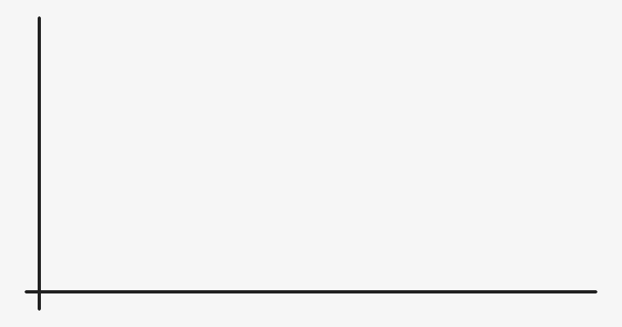

Regression
Notes:
Regression systems output a number for example how long it will take to drive from point A to point B or the likelihood that someone will click on an ad.
Regression systems can be as simple as drawing a line as you see above or more complex models depending on multiple variables.
Regression diagram source: Google (author: ostrowskid@)
Screenshot from Google Maps

Slide 24
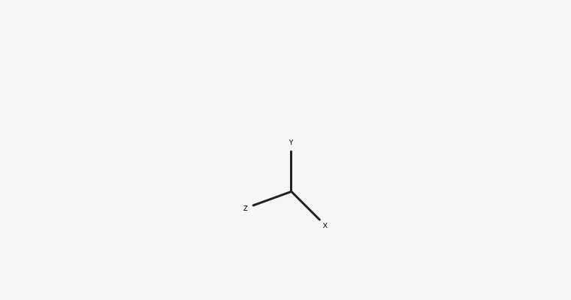
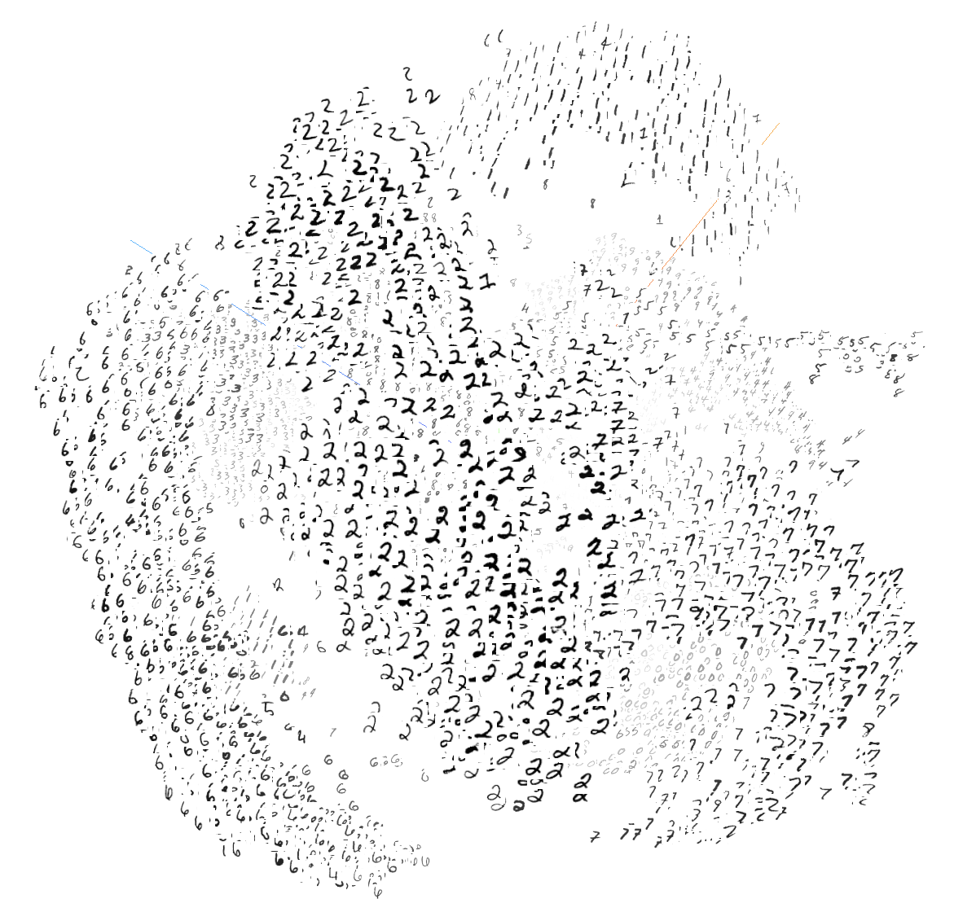

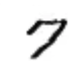
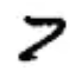
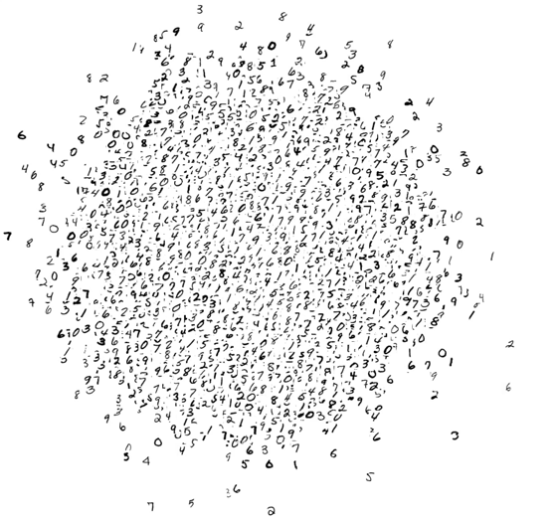



Clustering
Notes:
Another application of machine learning is determining how closely related items are to one another.
In this slide, the data of hand drawn images is moved into clusters of the same number (1s with 1s, 2s with 2s etc). Even within clusters of the same number, the images are further clustered by those which are similar in shape. For example, some 2s and 7s may look similar.
Clustering diagram source: Google (author: ostrowskid@)
Screenshots from the embedding projector

Slide 25

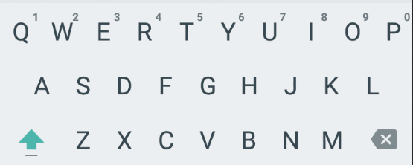
Sequence Prediction
Notes:
In order to assist users, it can be helpful to predict what they might do next. This could be a prediction of the next keyboard key a user will select as you see in the screenshot. This could be used to propose a spelling correction or suggest replies to a text message.
Other examples of sequence prediction could include the next video a user might want to watch or a next stop on a vacation.
Sequence diagram source: Google (author: ostrowskid@)
Keyboard source: Google

Slide 26

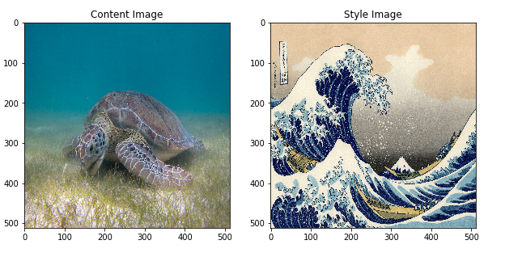
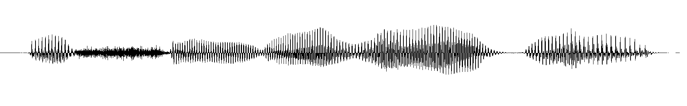
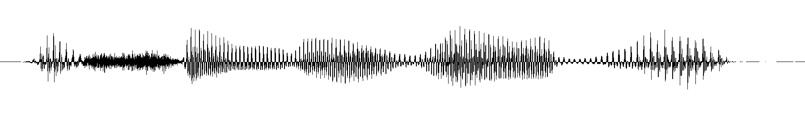
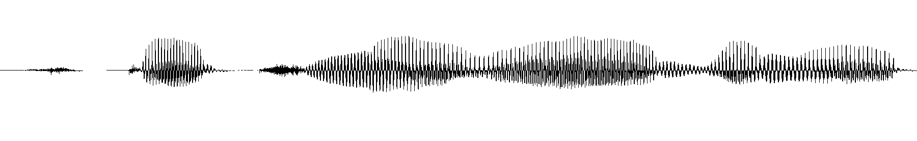
Style Transfer
+
=
EN Male
EN Female
JP Male
Notes:
Style Transfer or Generation involves training a model on one set of data and then applying that model to something completely different. It could be as seen in this example remaking photographs to look like another piece of art or translating a voice from male to female or even another language.
Now that you have seen a few examples of machine learning, let's go through some other examples and you tell me which type of machine learning best describes it. I say "best" because some problems can be solved by multiple approaches to machine learning.
Image Source: https://medium.com/tensorflow/neural-style-transfer-creating-art-with-deep-learning-using-tf-keras-and-eager-execution-7d541ac31398
Audio samples from https://deepmind.com/blog/wavenet-launches-google-assistant, visualized with Audacity software

Slide 27
Type of Machine Learning?
Classification
Clustering
Recommending what someone will download based on previous purchases.
Regression
Sequence Prediction
Sequence Prediction
Style Transfer
Notes:
[Animated slide: Click to show answer]
Answer: Sequence Prediction
Ask why. Explanations could include:
While all examples of machine learning involve previous examples, this is an example of predicting the next thing a person will do based on previous/similar sequences the model has learned from.

Slide 28
Type of Machine Learning?
Classification
Classification
Clustering
Labeling email as spam or not-spam
Regression
Sequence Prediction
Style Transfer
Notes:
[Animated slide: Click to show answer]
Answer: Classification
Ask why. Explanations could include:
When the goal is to output discrete prediction labels like yes/no, spam/not-spam this is a good fit for a classification system.

Slide 29
Type of Machine Learning?
Classification
Clustering
Clustering
Identifying trends amongst a group of people who have bought a new music release
Regression
Sequence Prediction
Style Transfer
Notes:
[Animated slide: Click to show answer]
Answer: Clustering
Ask why. Explanations could include:
The goal for this problem is less about making a specific prediction (like the sequence prediction example earlier) but looking for similarities and finding clusters/trends/groupings based on something in common.

Slide 30
Type of Machine Learning?
Classification
Clustering
Clustering
Grouping news headlines from different publications in the Google News app.
Regression
Sequence Prediction
Notes:
[Animated slide: Click to show answer]
Answer: Clustering
Explanations could include:
The goal for this problem is less about making a specific prediction (like the sequence prediction example earlier) but looking for similarities and finding clusters/trends/groupings based on something in common.

Slide 31
Type of Machine Learning?
Classification
Clustering
Captioning a video
Regression
Sequence Prediction
Style Transfer
Style Transfer
Notes:
[Animated slide: Click to show answer]
Answer: Style Transfer
Ask why. Explanations could include:
When the type of data generated by the system is different than the input data, this is an example of a style transfer.
In this example the input data: video/image frames is translated into text describing what is depicted in the image.

Slide 32
Type of Machine Learning?
Classification
Classification
Clustering
Determining workout activity based on phone movement.
Regression
Sequence Prediction
Style Transfer
Notes:
[Animated slide: Click to show answer]
Answer: Classification
Ask why. Explanations could include:
The goal is to output discrete labels such as walking, running, jumping which makes this task a good fit for classification.
Question: It's possible this could be determined without machine learning but there would be so many situations where a person could be working out but instead are driving a car. How would you improve an machine learning system to better understand the difference?
Ensure your model is trained with lots of examples of driving (the technical term in this situation is a false positive) and bicycling (also referred to as a true positive)

Slide 33
Type of Machine Learning?
Classification
Clustering
Predicting search terms in (Google) search engine using the autocomplete feature.
Regression
Sequence Prediction
Sequence Prediction
Notes:
[Animated slide: Click to show answer]
Answer: Sequence Prediction
[Trainer asks why] Explanations could include:
Sequence prediction involves predicting the next element of a sequence, the next value, on basis of the preceding elements.

Slide 34
Type of Machine Learning?
Classification
Classification
Clustering
Predicting the strength of a password
Regression
Regression
Sequence Prediction
Style Transfer
Notes:
[Animated slide: Click to show answer]
Answer: Classification or Regression
Ask why. Explanations could include:
When the output of a machine learning system is a continuous number such as "Your password is 50% stronger than others" it is a regression problem.
However your users might prefer you take that output and simply classify the output as Weak or Strong

Slide 35
Type of Machine Learning?
Classification
Classification
Clustering
Identifying famous landmarks in a photo
Regression
Sequence Prediction
Style Transfer
Notes:
[Animated slide: Click to show answer]
Answer: Classification
Ask why. Explanations could include:
When the output is a discrete label such as the Brandenburg Gate, Eiffel Tower, Taj Mahal, Great Wall of China, Statue of Liberty, etc it is a classification problem.

Slide 36
Type of Machine Learning?
Classification
Clustering
Clustering
Suggesting spelling corrections
Regression
Sequence Prediction
Style Transfer
Notes:
[Animated slide: Click to show answer]
Answer: Clustering because words which are misspelled may end up closer to the correct spelling than a completely different word.
Ask why. Explanations could include:
Clustering is a useful approach for this problem because misspelled words tend to be closer to the intended word. Also if another word entirely was intended such as:
Advocate (EN), Avocate (FR)
Avocado (EN), Avocat (FR)
These words would be close together as well.
It is possible to build a spelling checker using traditional approaches but they would be complex, of lower quality, and need to be adapted to fit new words and slang.

Slide 37
Type of Machine Learning?
Classification
Clustering
Predicting the quality score for an advertisement
Regression
Regression
Sequence Prediction
Style Transfer
Notes:
[Animated slide: Click to show answer]
Answer: Regression
Ask why. Explanations could include:
The output of the machine learning system is a continuous numerical score such as 3 out of 10 or 97.2%. This score would probably be based on numerous features.

Slide 38
Type of Machine Learning?
Classification
Clustering
Estimating arrival time based on time of day and traffic.
Regression
Regression
Sequence Prediction
Style Transfer
Notes:
[Animated slide: Click to show answer]
Answer: Regression
Ask why. Explanations could include:
Again, the output of this system is a numerical value such as 1 hour and 5 minutes.

Slide 39
Type of Machine Learning?
Classification
Clustering
Translating between two languages
Regression
Sequence Prediction
Style Transfer
Style Transfer
Notes:
[Animated slide: Click to show answer]
Answer: Style Transfer
Ask why. Explanations could include:
Although both of the input types may be the same (text, audio) the languages are different.
A translation model trained for one language could be retrained to translate between other languages.
Some translation tools use programmed rules to translate from one language to another but increasing in quality requires they grow more complex.
Languages may not have clear rules for translation between languages such as French and Mandarin Chinese.

Slide 40
Questions / Review
What is ML?
ML vs Rule-based
Idea to Implementation
AI vs ML vs Deep Learning
History of ML
Types of ML [Classification, Clustering, Regression, Sequence Prediction, Style Transfer]
Notes:
If time allows, ask students to summarize each of these topics or ask questions.

